Slide 1

GROCERY STORE
B.Tech T.Y.
Division IT-A
NAME – SRUSHTI SHINGADE
ROLL NO - 57
SOFTWARE DEVELOPMENT PROJECT(SDP)
Vishwakarma Institute of Technology, Pune

Slide 2

OUTLINE
Introduction
objectives and aim
LITERATURE REVIEW
PROBLEM STATEMENT
background
Implementation
Results and discussion
Conclusion and Future Scope
References

Slide 3
Introduction
Application software is computing software designed to carry out a specific task.
Application software's reduce our both physical as well as mental efforts.
They are handy and save a lot of time .
Effective and worthy output by them assists us to look after our difficulties.

Slide 4
Introduction
In very identical manner Grocery Store is designed .
Many issues/complications are being faced in order to buy grocery and face the crowd in this pandemic situation.
The problems and difficulties faced by each and every individual about the grocery concern will get easily and effectively resolved using the Grocery Store.
It basically includes two modules.
For Admin
For User

Slide 5
objectives
Objectives :
To sort all of the problems related to buying of the grocery.
To provide finest products.
To reduce mental and physical efforts.
To guarantee good delivery and payment options.
Maintaining social distancing while delivery of the products.

Slide 6
background
Gathering of information related to grocery products
Perfect allocation of prices to each product
Making traveling in local places handy by providing best means of transport within destination.
Making it easier for the citizens to order whatever they want in online mode

Slide 7
Implementation
Frontend/UI – HTML, CSS, Javascript, Bootstrap
Language used - PHP
Database - MySQL
Visual Studio Code(VSCode) Editor being used as means of Technology for process
phpMyAdmin is used for the database design.
Software – xampp
Browser – Google Chrome, Mozilla, OPERA, IE8

Slide 8
Implementation (Cont.)
Methodology Implemented:
Steps involved in developing application
1] Getting thorough information about GUI toolkits applicable in php
2] Creating a database
3] Getting information about the connections to be made between the database and the backend
4] Searching for required database contents
5] Storing given information in memory and using the same whenever needed
6] Assembling various interfaces in sequence as per the demand of user's preference using commands displayed by buttons

Slide 9
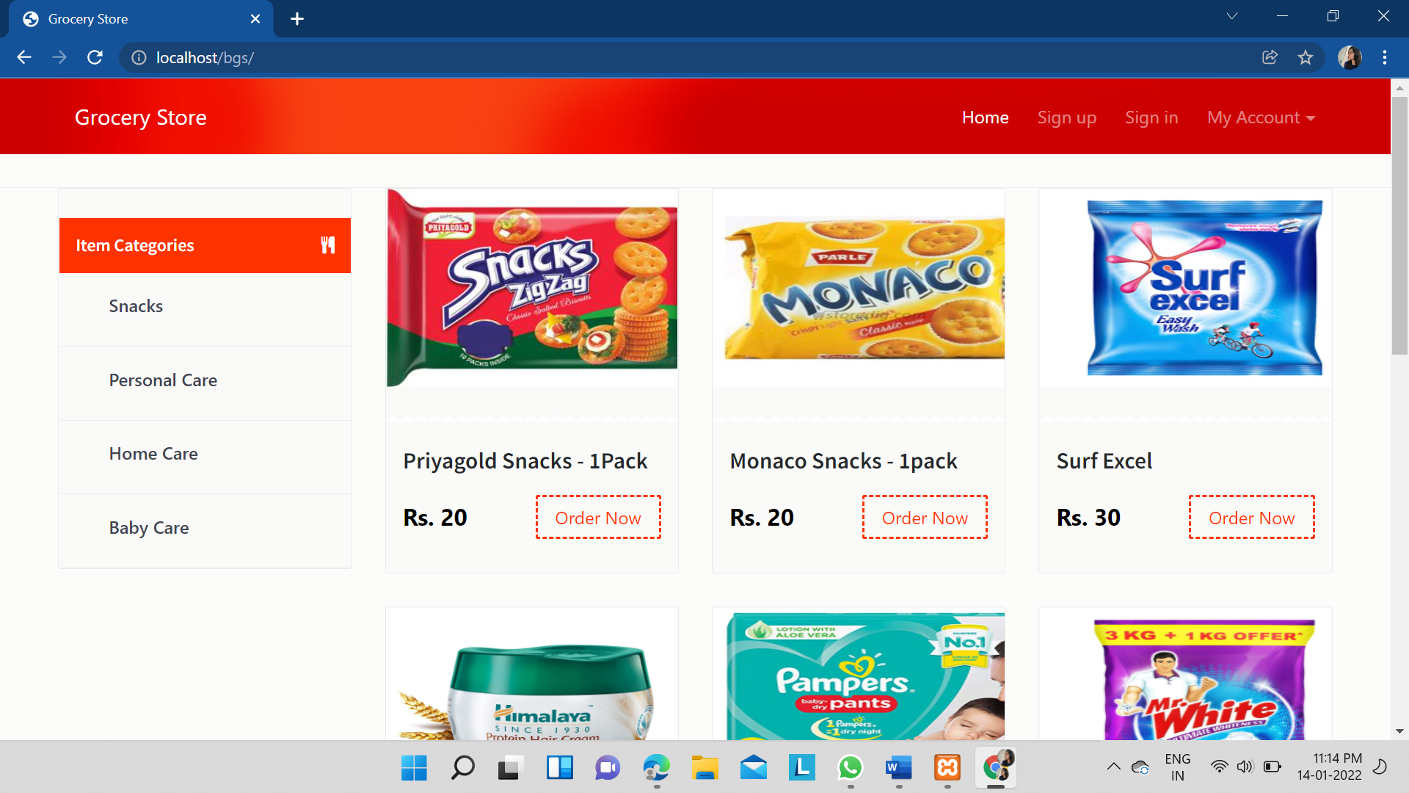
RESULTS

Slide 10
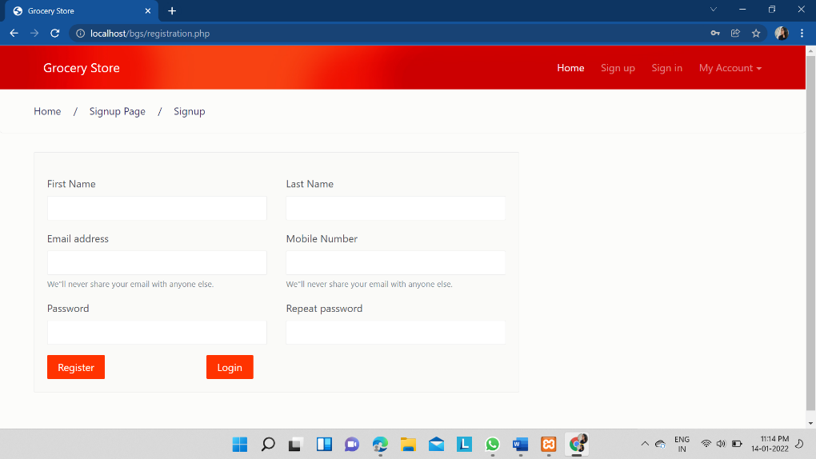
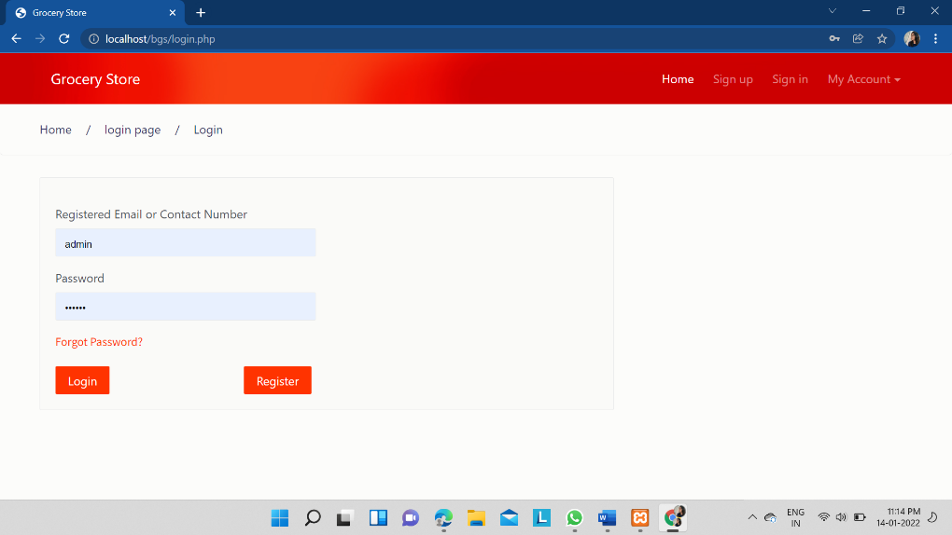
RESULTS(CONT.)

Slide 11
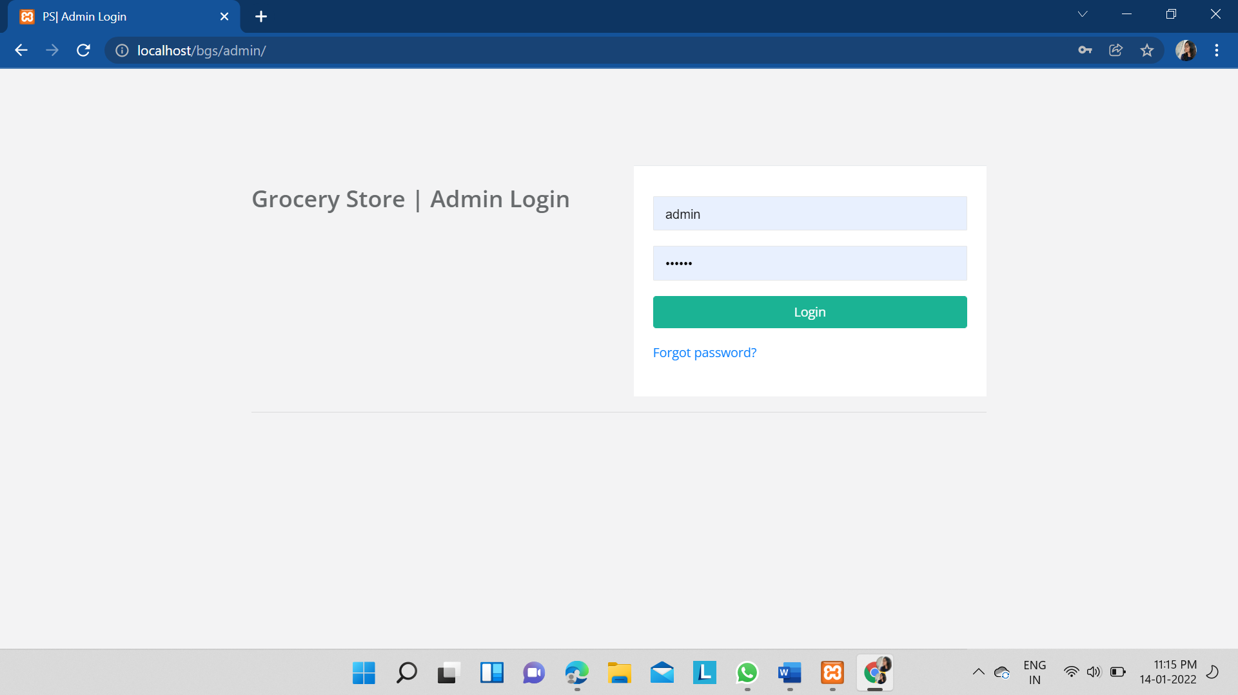
RESULTS(CONT.)

Slide 12
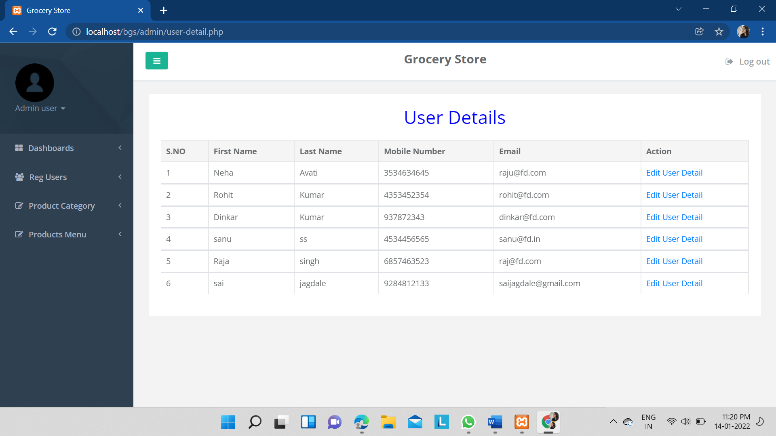
RESULTS(CONT.)

Slide 13
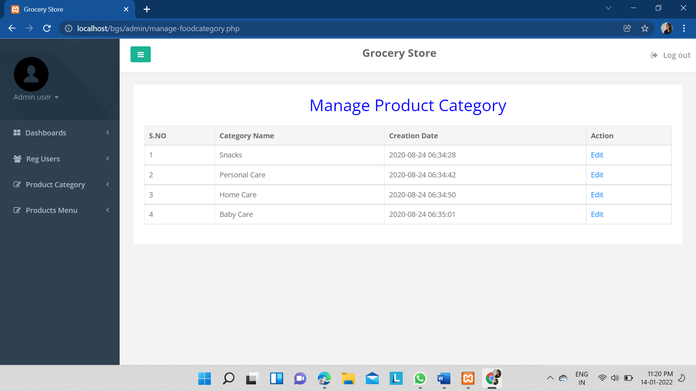
RESULTS(CONT.)

Slide 14
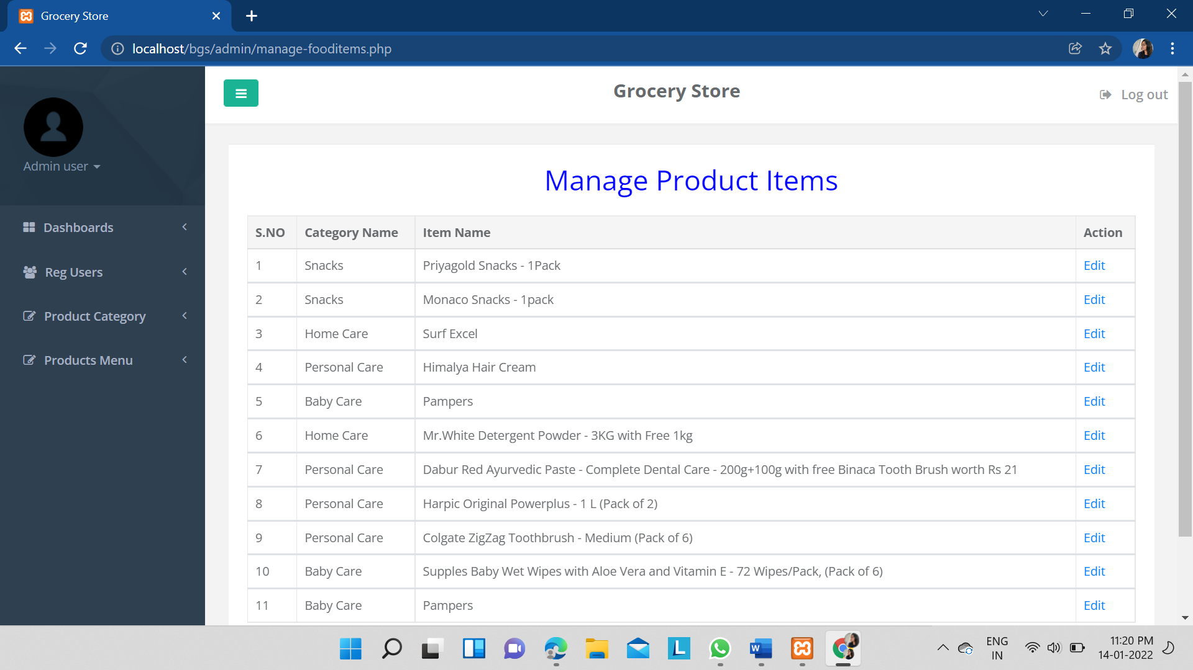
RESULTS(CONT.)

Slide 15
CONCLUSION
Home Delivery is currently recognized as a global industry which is highly growing at a high rate like other industries.
The ‘Grocery Store’ helps in online distribution of grocery
This application provides such user friendly interface that allows the customers to control and handle the functionalities effectively and efficiently.

Slide 16
FUTURE SCOPE
Using GPS technology and mathematical modeling software to track the location of the customer to deliver their products on correct location.
Adding each and every product in different quantities so it can be profitable and also handy to order less or more amount of grocery accordingly.
Customer reviews and feedback.
Joining hands with the delivering companies.

Slide 17
References
https://www.researchgate.net/publication/38178214_Online_grocery_shopping_The_influence_of_situational_factors
https://www.researchgate.net/publication/324806028_A_Study_on_Consumers_acuity_towards_online_grocery_shopping
https://iosrjournals.org/iosr-jbm/papers/Conf.15010/Volume%202/25.%2048-53.pdf
Microsoft Word - Consumer Attitudes Towards Online Grocery Shopping.docx (diva-portal.org)

Slide 18
Thank You

